Slide 1
13/03/2020
Quadrilaterals

Slide 2
Learning Goal
To identify quadrilateral properties and find the sum of the angles.

Slide 3
Rotational Symmetry
The order of rotational symmetry of a shape is determined by how many times the shape fits onto itself during a 360° turn.
Every shape has an order of rotational symmetry, even if it is order 1
Have a look at the following shapes…

Slide 4
Eg1. A square
It fits on itself 4 times
back
order 4
We say that a square has…

Slide 5
Eg2. A heart shape
It fits on itself only once
back
order 1
We say that a heart has…

Slide 6
What is the order of rotational symmetry?
order 6
answer

Slide 7
Activity 1 – Show me
A question will appear on the screen.
The answers are multiple choice. Write the answer on your paper.
When I tell you to, share your answer.

Slide 8
How many lines of reflective symmetry does this shape have?
Q1
square
6
2
4

Slide 9
Name this shape
Q2
parallelogram
kite
rhombus

Slide 10
How many angles are equal?
Q3
trapezoid
0
4
2
Notes:
Trapezium

Slide 11
How many pairs of parallel sides does this shape have?
Q4
parallelogram
2
0
1

Slide 12
How many lines of reflective symmetry does this rectangle have?
Q5
4
2
0

Slide 13
Name this shape
Q6
parallelogram
kite
rhombus
Notes:
2 pairs of parallel sides and all sides equal.

Slide 14
How many lines of rotational symmetry does this shape have?
Q7
Order 2
rectangle
2
8
4

Slide 15
Name this shape
Q8
trapezoid
parallelogram
kite

Slide 16
Name this shape
Q9
kite
quadrilateral
trapezoid

Slide 17
Q10
Which shape is the odd one out?
A quadrilateral is a shape with four straight lines

Slide 18
Activity 2 – Quadrilateral investigation
Draw a quadrilateral (using a ruler) and label the angles A, B, C and D.
Cut out the quadrilateral and tear off each of the corners.
Arrange the torn-off corners so that the angles A, B, C and D meet around a common point.
What does this tell you about the angles in a quadrilateral?

Slide 19
Activity 3: THINK – PAIR - SHARE
What is the name of this shape?
How could you work out the missing angle a?
a
parallelogram
65°
360 - (115 + 115 + 65) = 65° for the missing interior angle.
115 ̊
Not drawn to scale
115 ̊
65 ̊
Remember: The interior angles in a quadrilateral add up to 360°

Slide 20
Activity 4: THINK – PAIR - SHARE
How could you work out the missing angle e?
e
95°
120 ̊
360 - (120 + 80 + 65) = 95° for the missing interior angle.
Not drawn to scale
80 ̊
65 ̊
Remember: The interior angles in a quadrilateral add up to 360°

Slide 21
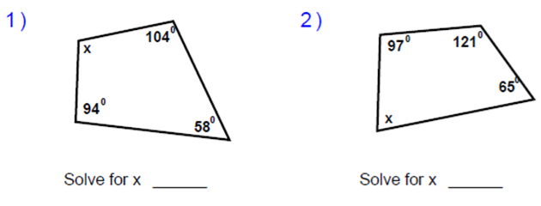
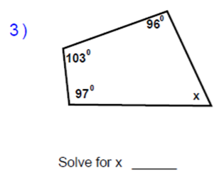
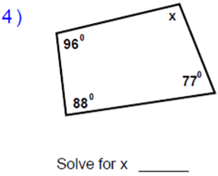
Activity 5 – Find the missing angles. Show your work.
4 minutes
x = 104⁰
x = 77⁰
x = 64⁰
x = 99⁰

Slide 22
Extension
Not drawn to scale
63°
a = 159°
b = 109°
c = 100°
d = 21°
e = 76°
f = 110°
g = 70°
h = 204°
i = 64°
a
80°
c
d
58°
g
80°
h
i
e
f
70°
71°
b
105°
Notes:
EXTENSION - BLUE PAPER

Slide 23
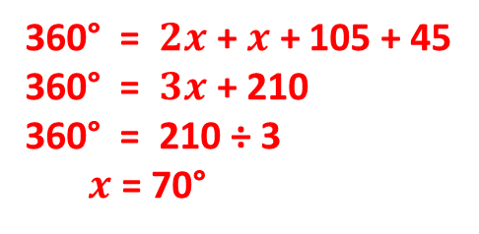
Extension
Not drawn to scale
a)
105°
b)
110°
$$2x$$
2 x 70° = 140°
$$2x$$
2 x 50° = 100°
For each angle
$$2x$$
45°
70°
$$x$$
360° = $2x$ + $x$ + 105 + 45
360° = $3x$ + 210
360° = 210 ÷ 3
$x$ = 70°
c)
$$x$$
50°
100°
$$x$$
$$2x$$
30°
30°
2 x 100° = 200°
Notes:
EXTENSION - BLUE PAPER

Slide 24
Activity 7
Do any of these sets of angles form the four interior angles of a quadrilateral?
135°, 75°, 60°, 80°
150°, 60°, 80°, 70°
85°, 85°, 120°, 60°
d) 80°, 90°, 90°, 110°
e) 95°, 95°, 60°, 110°
f) 102°, 138°, 90°, 30°
No = 350°
Yes = 360°
No = 350°
No = 370°
Yes = 360°
Yes = 360°

Slide 25
Plenary
Name this shape
Multiple choice
A: 75°
B: 85°
C: 95°
D: 105°
E: 285°
Work out the size of angle x

Slide 26
Plenary ANSWER
We have learnt that all the interior angles in a quadrilateral add up to 360°
360 - (35 + 15 + 25) = 285° for the missing interior angle.
We also know that angles around a point add up to 360°
So …
$x$= 360° - 285°
$x$= 75°
Quadrilateral

Slide 27
Extension
Not drawn to scale
63°
a =
b =
c =
d =
e =
f =
g =
h =
i =
a
80°
c
d
58°
g
80°
h
i
e
f
70°
71°
b
105°
Notes:
EXTENSION - BLUE PAPER

Slide 28
Extension
Not drawn to scale
a)
105°
b)
110°
$$2x$$
$$2x$$
$$2x$$
45°
$$x$$
c)
$$x$$
$$x$$
$$2x$$
30°
30°
Notes:
EXTENSION - BLUE PAPER

